Slide 1
HeuristicLab 3.0
Overview

Slide 2
Motivation
genericity
no focus on any particular heuristic optimization paradigm
suitable for any kind of algorithm
suitable for any kind of problem and solution representation
modularity
plug-ins
usability
extensive use of graphical user interfaces (WinForms)
step-wise algorithm execution
persistence
interactive algorithm engineering
parallelism
integration of parallel algorithms
separation of algorithms and parallelization concept

Slide 3
Plugin Infrastructure
using HeuristicLab.PluginInfrastructure;
namespace MyProject {
[ClassInfo(Name = "My Project", Version = "0.99.0.0", Description = "Just an example plugin")]
[PluginFile(Filename = "MyProject.dll", Filetype = PluginFileType.Assembly)]
[PluginFile(Filename = "ZipLibrary.dll", Filetype = PluginFileType.Assembly)]
[PluginFile(Filename = "Database.db", Filetype = PluginFileType.Data)]
[Dependency(Dependency = "HeuristicLab.Data")]
[Dependency(Dependency = "HeuristicLab.Random")]
public class MyProjectPlugin : PluginBase {
}
}
a plugin can contain multiple files (assemblies, data files, images, icons, …)
plugins may depend on each other
plugin meta-data (descriptions, dependencies, etc.) are stored in the code files (attributes)
no XML description file like in HeuristicLab 2.0
plugin infrastructure enables drop-in installation (similar to eclipse)

Slide 4
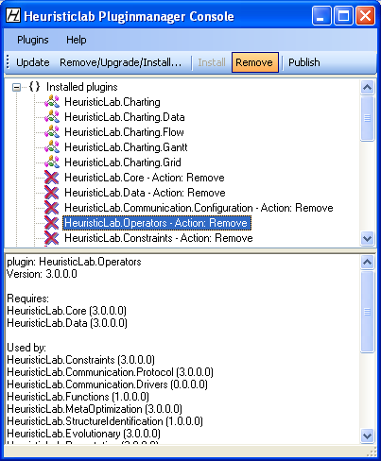
Plugin Infrastructure
plugin manager
inspired by Debian package management system
plugins are deployed as ZIP archives
plugin manager minds dependencies
required plugins are automatically installed
dependent plugins are automatically removed
HTTP-based updating of plugins
plugins can be installed and removed at runtime
each application has its own application domain

Slide 5
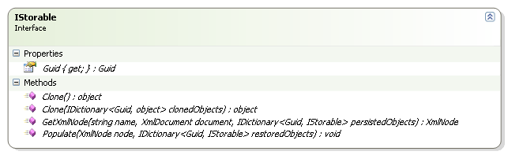
Persistence
basic interface IStorable
defines unique identifier (GUID)
Guid Guid { get; }
defines methods for cloning
object Clone()
object Clone(IDictionary<Guid, object> clonedObjects)
defines methods for persisting to and restoring from XML
XmlNode GetXmlNode(string name, XMLDocument document, IDictionary<Guid, IStorable> persistedObjects>)
void Populate(XmlNode node, IDictionary<Guid, IStorable> restoredObjects)
implemented by abstract base class StorableBase
multiple references to a single object are handled correctly
cyclical object graphs can be cloned or persisted automatically
deep cloning is used by default

Slide 6
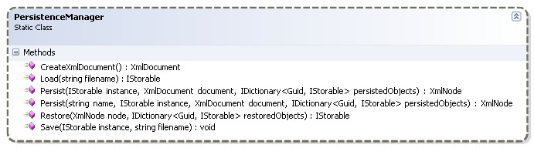
Persistence
static class PersistenceManager
provides auxiliary methods for persistence
Load and Save to write IStorable to or to restore it from disk
Persist and Restore to start persisting or restoring of single IStorable
by default type names are used as XML tags
Persist offers parameter (name) to specify some other name as XML tag

Slide 7
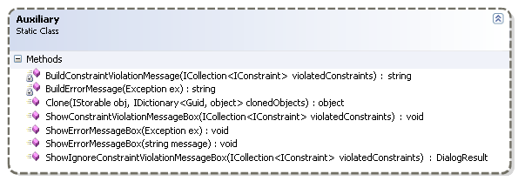
Persistence
static class Auxiliary
provides auxiliary method for cloning
Clone to start cloning of a single IStorable
checks if cloning is necessary or if object has already been cloned
provides several other methods for showing error messages
methods of PersistenceManager and Auxiliary have to be used to enable correct persisting / cloning of cyclical object graphs

Slide 8
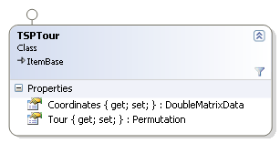
Persistence
persistence code in class TSPTour
example XML snippet
public override XmlNode GetXmlNode(string name, XmlDocument document, IDictionary<Guid, IStorable> persistedObjects) {
XmlNode node = base.GetXmlNode(name, document, persistedObjects);
node.AppendChild(PersistenceManager.Persist("Coordinates", Coordinates, document, persistedObjects));
node.AppendChild(PersistenceManager.Persist("Tour", Tour, document, persistedObjects));
return node;
}
public override void Populate(XmlNode node, IDictionary<Guid, IStorable> restoredObjects) {
base.Populate(node, restoredObjects);
myCoordinates = (DoubleMatrixData)PersistenceManager.Restore(node.SelectSingleNode("Coordinates"), restoredObjects);
myTour = (Permutation)PersistenceManager.Restore(node.SelectSingleNode("Tour"), restoredObjects);
}
<VariableInjector Type="HeuristicLab.Operators.VariableInjector, HeuristicLab.Operators" GUID="65e6153d-18a6-4a9a-9b04-77732e8612b6"
Name="VariableInjector">
<SubOperators />
<VariableInfos />
<Variables>
<Variable Type="HeuristicLab.Core.Variable, HeuristicLab.Core" GUID="d971503d-2ed0-43b2-bc6b-1bce4676dc51" Name="PopulationSize">
<Value Type="HeuristicLab.Data.IntData, HeuristicLab.Data" GUID="0f36459e-1910-4852-91a6-ec37a9767df7">100</Value>
</Variable>
<Variable Type="HeuristicLab.Core.Variable, HeuristicLab.Core" GUID="cb899fcb-76c3-4f86-9699-91cb6ee62420" Name="EvaluatedSolutions">
<Value Type="HeuristicLab.Data.IntData, HeuristicLab.Data" GUID="4bd5b9ae-4ee2-4063-8e17-37972eae50b7">0</Value>
</Variable>
</Variables>
</VariableInjector>

Slide 9
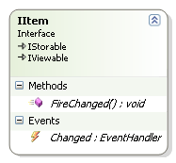
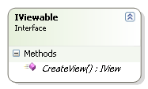
Items
interface IItem
implements IStorable and IViewable
base class for (almost) every HeuristicLab object
data, variables, operators, engines, …
defines Changed event
defines method FireChanged to fire Changed event manually
has to be called if contained complex objects are changed and don't provide an event-based notification (arrays, e.g.)
implemented by abstract base class ItemBase
interface IViewable
defines method CreateView for creating a view for an object
usually a view is a Windows Forms control
implemented by base class ViewBase
all objects implementing IItem can be shown on the user interface (GUI)
views of complex objects can be assembled using views of their parts
strict use of MVC pattern

Slide 10
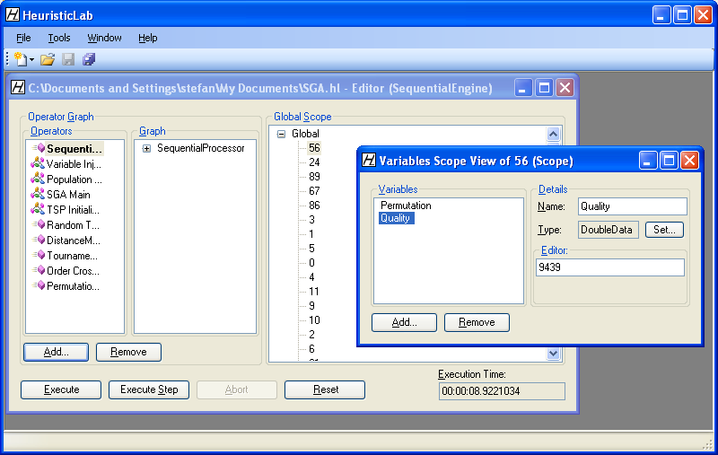
Views
Engine
Operator
Graph
Scope
Scope
Variable
Data

Slide 11
Modeling Algorithms
what is an algorithm?
3 main aspects
instructions
sequence of execution
result
we have to model
operators modifying data
graphs of operators representing the sequence of execution
"A finite set of unambiguous instructions performed in a prescribed sequence to achieve a goal, especially a mathematical rule or procedure used to compute a desired result. Algorithms are the basis for most computer programming."
© The American Heritage Dictionary of the English Language

Slide 12
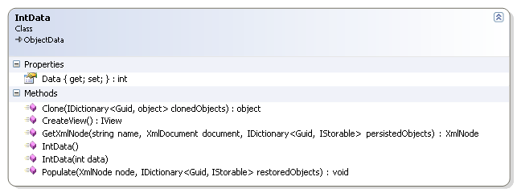
Data
data is represented as objects
data objects have to implement IItem (are storable and viewable)
persistence methods have to be implemented
custom views can be provided
namespace HeuristicLab.Data contains several ready to use data objects
wrapper objects for system types
IntData, IntArrayData, IntMatrixData, DoubleData, …
collections
ItemList

Slide 13
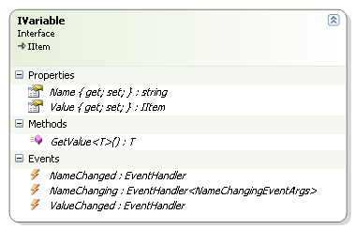
Variables
operators manipulate data
data objects need names to be accessible
interface IVariable
contains name (Name) and data object (Value)
defines generic method GetValue to access value
various events to signal changes (MVC)
implemented by Variable
IVariable implements IItem
variables themselves can be values of variables
required for meta-programming
more on that later …

Slide 14
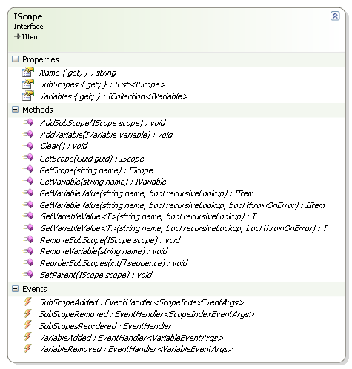
Scopes
variables are organized in scopes
interface IScope
hierarchical container of variables
contains variables (Variables)
contains sub-scopes (SubScopes)
defines several methods to get/add/remove variables and sub-scopes
defines method GetVariableValue to perform recursive variable lookup towards the root scope
variables with identical names hide variables of parent scopes
events to signal changes (MVC)
implemented by Scope
scopes build an n-ary tree structure
operators work on scopes
get variables, manipulate, write back

Slide 15
Operators
operators represent basic instructions of algorithms
operators manipulate scopes (modify variables and/or sub-scopes)
operators decide which operators are executed next
interface IOperator
contains sub-operators (SubOperators)
contains local variables (Variables)
contains meta-information about variables (VariableInfos)
defines methods to manipulate its data
events to signal changes
defines method Execute to execute the operator on a specific scope
defines GetVariableValue methods for conveniant variable lookup (either in the local variables or in the scope)
implemented by abstract base class OperatorBase
operators store references to their successor operators (sub-operators)
build a graph structure (execution graph)

Slide 16
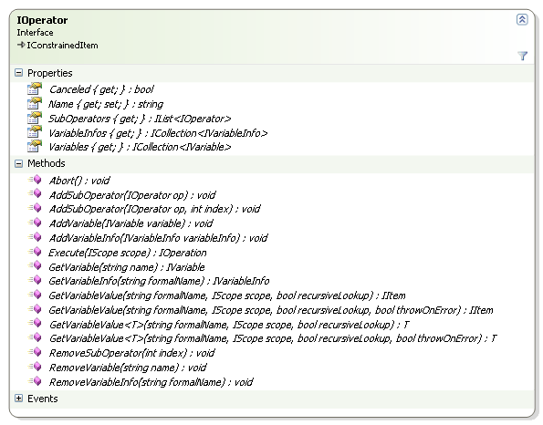
Operators

Slide 17
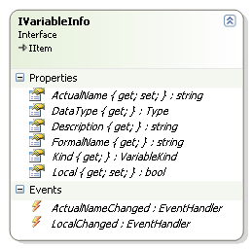
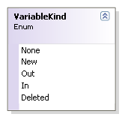
Variable Infos
operators have to be independent of concrete variable names
for example, functionality of a counter operator:
get variable from scope
increase the variable's value by 1
write new variable value back into the scope
mechanism needed to translate formal variable names into actual variable names
formal variable name is used by the operator to identify a variable
actual variable name is the real name of the variable in the scope
interface IVariableInfo
stores meta-information about variables
actual name, formal name, data type, description, kind, …
used by operators to define which variables are required
each operator has to define a variable info object for each variable it requires
usually done in the operator's constructor
actual names can be set by the user when assembling an algorithm
formal/actual name translation is automatically performed when using an operators GetVariableValue method

Slide 18
Example: Counter
public class Counter : OperatorBase {
public Counter() {
AddVariableInfo(
new VariableInfo("Value", // formal name
"Counter value", // description
typeof(IntData), // data type
VariableKind.In | VariableKind.Out) // kind
);
}
public override IOperation Apply(IScope scope) {
// perform formal/actual name translation
IntData value = GetVariableValue<IntData>("Value", scope, true);
value.Data++;
return null;
}
}

Slide 19
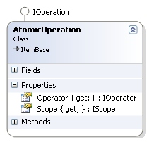
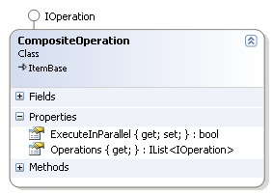
Operations
operators store references to their sub-operators
after execution operators have to decide which operators are executed next
to enable step-wise execution and parallelism operators should not directly execute their successor operators
operators that should be executed next and the corresponding scopes are represented as operations and returned to the engine
interface IOperation
marker interface inherited from IItem
doesn't contain anything
implemented by AtomicOperation and CompositeOperation (composite pattern)
class AtomicOperation
represents a single operation
contains an operator (Operator) and a scope (Scope) on which the operator should be executed
class CompositeOperation
represents an operation consisting of several other operations
contains a collection of sub-operations (Operations)
contains flag to indicate if sub-operations can be executed in parallel (ExecuteInParallel)

Slide 20
Example: ConditionalBranch
public class ConditionalBranch : OperatorBase {
public ConditionalBranch() {
AddVariableInfo(new VariableInfo("Condition",
"A boolean variable that decides the branch",
typeof(BoolData),
VariableKind.In));
}
public override IOperation Apply(IScope scope) {
BoolData resultData = GetVariableValue<BoolData>("Condition", scope, true);
bool result = resultData.Data;
if (result)
return new AtomicOperation(SubOperators[0], scope); // true branch
else
return new AtomicOperation(SubOperators[1], scope); // false branch
return null;
}
}

Slide 21
Example: SequentialProcessor, UniformParallelSubScopesProcessor
public class SequentialProcessor : OperatorBase {
public override IOperation Apply(IScope scope) {
CompositeOperation next = new CompositeOperation();
for (int i = 0; i < SubOperators.Count; i++)
next.AddOperation(new AtomicOperation(SubOperators[i], scope));
return next;
}
}
public class UniformParallelSubScopesProcessor : OperatorBase {
public override IOperation Apply(IScope scope) {
CompositeOperation next = new CompositeOperation();
next.ExecuteInParallel = true;
for (int i = 0; i < scope.SubScopes.Count; i++)
next.AddOperation(new AtomicOperation(SubOperators[0], scope.SubScopes[i]));
return next;
}
}

Slide 22
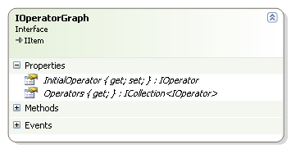
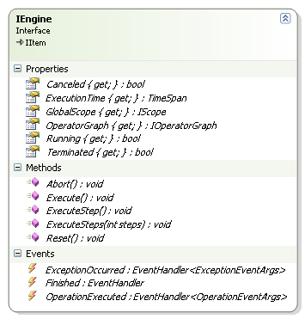
Engines
operators must not call their successor operators directly
engine is responsible for operator execution
engines are able to deal with parallelism
interface IOperatorGraph
represents an algorithm (a graph of operators)
contains an initial operator (InitialOperator) and a list of all operators (Operators)
implemented by OperatorGraph
interface IEngine
handles execution of operator graphs
contains an operator graph (OperatorGraph) and a global scope (GlobalScope)
defines methods to start, stop or abort execution
implemented by SequentialEngine and ThreadParallelEngine
each execution start with an empty global scope

Slide 23
Architecture
SGA
TSP
Selection
Random
Logging
Sequential Engine
ThreadParallel Engine
Permutation
Evolutionary
Operators
Constraints
Data
Core
Plugin Infrastructure
.NET 2.0 / 3.5

Slide 24
Demonstration

